Slide 1
Lecture 3: Market Failures: Examples and in Practice
Prof. Parthum
Environmental Economics Econ 475

Slide 2
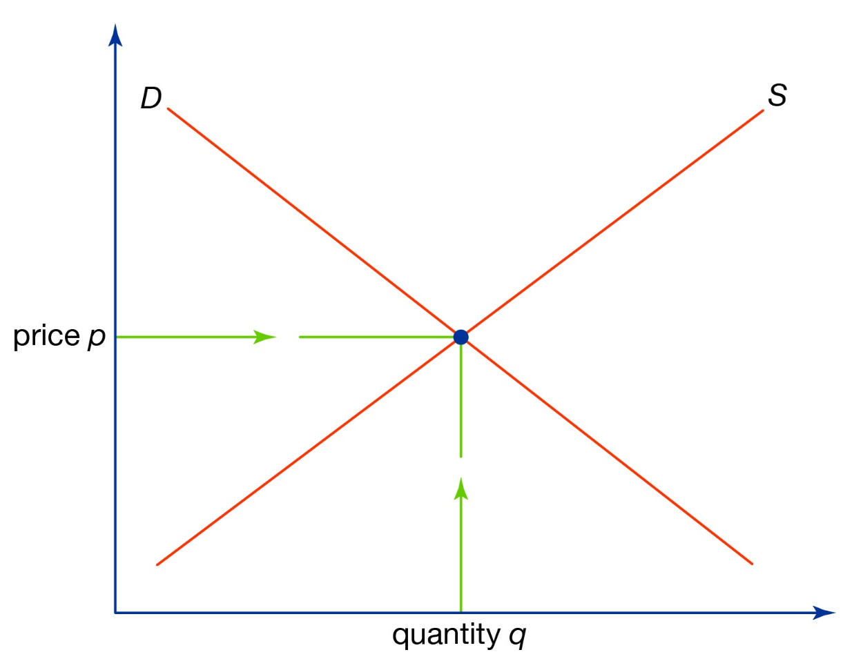



An Example: The Market for Plastic Bags
What’s missing?
The external marginal cost
Adding the external cost to the private recovers the (true) social marginal cost
The socially optimal number of bags is fewer than the private. The private market overprovides bags
What is a possible fix?
A tax equal to the external marginal cost
Value
Social
Marginal
Costs
Private
Marginal
Costs
Private
Marginal
Benefit
External
Marginal
Costs
$$tax$$
$$b_{s}^{∗}$$
$$b_{p}^{∗}$$
# of Bags

Slide 3



An Example: The Market for College Education
In education, the externality is a “good”
The private market would underprovide public education
A government subsidy can help correct this market failure
In this context, is the external marginal benefit actually fixed (flat)?
Try drawing an example of what you think external marginal benefits are
Value
Private
Marginal
Costs
Social
Marginal
Benefit
Private
Marginal
Benefit
External
Marginal
Benefit
$$subsidy$$
$$e_{s}^{∗}$$
$$e_{p}^{∗}$$
# of years in school

Slide 4
Market Failures
There are many different types or root causes of market failures. Think of some examples under each of these categories.
Information Asymmetries
One party in a transaction knows more than the other
Market Structure/Power
One party can influence the market equilibrium
Public Goods
Nonrival and nonexcludable
Externalities
Private actions have unintended effects

Slide 5
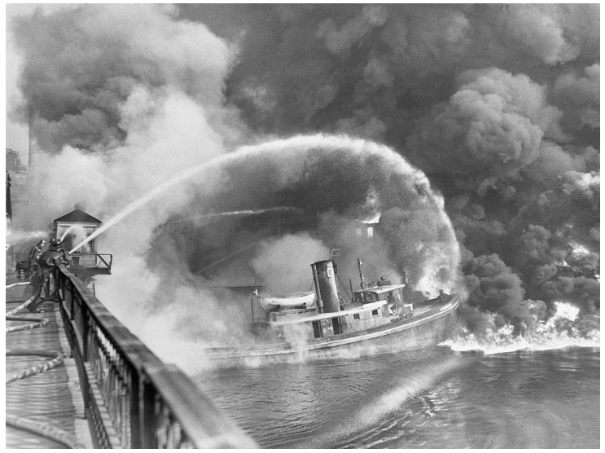
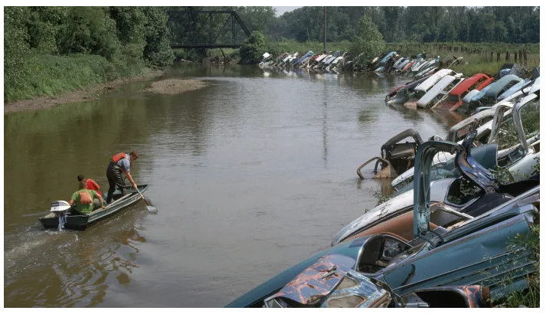
The Cuyahoga River Caught Fire at Least a Dozen Times, but No One Cared Until 1969
Source: history.com

Slide 6
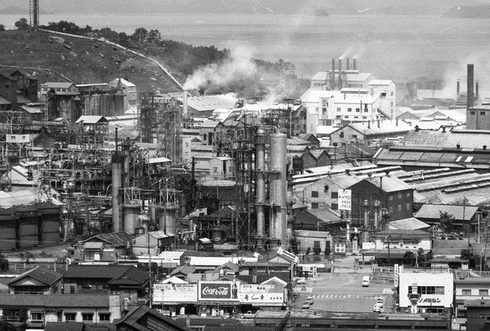

Minamata disease, 1956: the release of methylmercury in the industrial wastewater from a chemical factory owned by the Chisso Corporation
Source: Blind Magazine

Slide 7
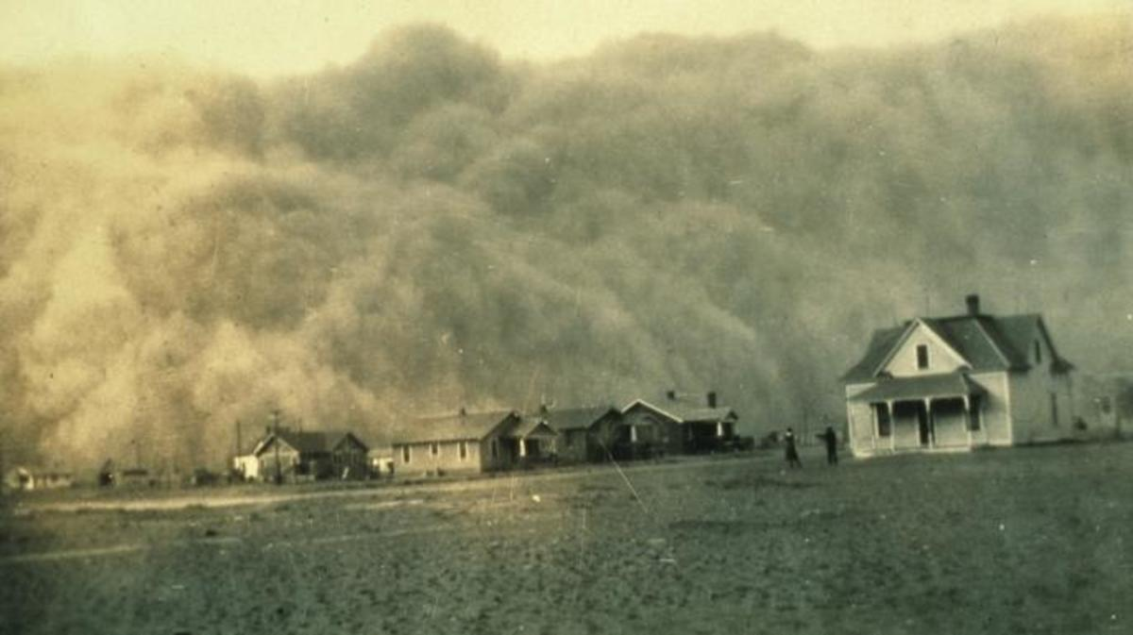

The Dust Bowl
As one “black blizzard” hit after another, harmful dust particles accumulated in people’s lungs, causing hundreds of deaths and sickening thousands.
Source: history.com

Slide 8
Bag Leakage: The Effect of Disposable Carryout Bag
Regulations on Unregulated Bags
By: Dr. Rebecca Taylor
Abstract: Leakage occurs when partial regulation of consumer products results in increased consumption of these products in unregulated domains. This article quantifies plastic leakage from the banning of plastic carryout bags. Using quasi-random policy variation in California, I find the elimination of 40 million pounds of plastic carryout bags is offset by a 12-million-pound increase in trash bag purchases—with small, medium, and tall trash bag sales increasing by 120%, 64%, and 6%, respectively. The results further reveal 12–22% of plastic carryout bags were reused as trash bags pre-regulation and show bag bans shift consumers towards fewer but heavier bags. With a substantial proportion of carryout bags already reused in a way that avoided the manufacture and purchase of another plastic bag, policy evaluations that ignore leakage effects overstate the regulation’s welfare gains.

Slide 9
Bag Leakage: The Effect of Disposable Carryout Bag
Regulations on Unregulated Bags
By: Dr. Rebecca Taylor
Abstract: Leakage occurs when partial regulation of consumer products results in increased consumption of these products in unregulated domains. This article quantifies plastic leakage from the banning of plastic carryout bags. Using quasi-random policy variation in California, I find the elimination of 40 million pounds of plastic carryout bags is offset by a 12-million-pound increase in trash bag purchases—with small, medium, and tall trash bag sales increasing by 120%, 64%, and 6%, respectively. The results further reveal 12–22% of plastic carryout bags were reused as trash bags pre-regulation and show bag bans shift consumers towards fewer but heavier bags. With a substantial proportion of carryout bags already reused in a way that avoided the manufacture and purchase of another plastic bag, policy evaluations that ignore leakage effects overstate the regulation’s welfare gains.

Slide 10
Bag Leakage: The Effect of Disposable Carryout Bag
Regulations on Unregulated Bags
By: Dr. Rebecca Taylor
Abstract: Leakage occurs when partial regulation of consumer products results in increased consumption of these products in unregulated domains. This article quantifies plastic leakage from the banning of plastic carryout bags. Using quasi-random policy variation in California, I find the elimination of 40 million pounds of plastic carryout bags is offset by a 12-million-pound increase in trash bag purchases—with small, medium, and tall trash bag sales increasing by 120%, 64%, and 6%, respectively. The results further reveal 12–22% of plastic carryout bags were reused as trash bags pre-regulation and show bag bans shift consumers towards fewer but heavier bags. With a substantial proportion of carryout bags already reused in a way that avoided the manufacture and purchase of another plastic bag, policy evaluations that ignore leakage effects overstate the regulation’s welfare gains.

Slide 11
Bag Leakage: The Effect of Disposable Carryout Bag
Regulations on Unregulated Bags
By: Dr. Rebecca Taylor
Abstract: Leakage occurs when partial regulation of consumer products results in increased consumption of these products in unregulated domains. This article quantifies plastic leakage from the banning of plastic carryout bags. Using quasi-random policy variation in California, I find the elimination of 40 million pounds of plastic carryout bags is offset by a 12-million-pound increase in trash bag purchases—with small, medium, and tall trash bag sales increasing by 120%, 64%, and 6%, respectively. The results further reveal 12–22% of plastic carryout bags were reused as trash bags pre-regulation and show bag bans shift consumers towards fewer but heavier bags. With a substantial proportion of carryout bags already reused in a way that avoided the manufacture and purchase of another plastic bag, policy evaluations that ignore leakage effects overstate the regulation’s welfare gains.

Slide 12
Bag Leakage: The Effect of Disposable Carryout Bag
Regulations on Unregulated Bags
By: Dr. Rebecca Taylor
Abstract: Leakage occurs when partial regulation of consumer products results in increased consumption of these products in unregulated domains. This article quantifies plastic leakage from the banning of plastic carryout bags. Using quasi-random policy variation in California, I find the elimination of 40 million pounds of plastic carryout bags is offset by a 12-million-pound increase in trash bag purchases—with small, medium, and tall trash bag sales increasing by 120%, 64%, and 6%, respectively. The results further reveal 12–22% of plastic carryout bags were reused as trash bags pre-regulation and show bag bans shift consumers towards fewer but heavier bags. With a substantial proportion of carryout bags already reused in a way that avoided the manufacture and purchase of another plastic bag, policy evaluations that ignore leakage effects overstate the regulation’s welfare gains.

Slide 13
Bag Leakage: The Effect of Disposable Carryout Bag
Regulations on Unregulated Bags
By: Dr. Rebecca Taylor
Abstract: Leakage occurs when partial regulation of consumer products results in increased consumption of these products in unregulated domains. This article quantifies plastic leakage from the banning of plastic carryout bags. Using quasi-random policy variation in California, I find the elimination of 40 million pounds of plastic carryout bags is offset by a 12-million-pound increase in trash bag purchases—with small, medium, and tall trash bag sales increasing by 120%, 64%, and 6%, respectively. The results further reveal 12–22% of plastic carryout bags were reused as trash bags pre-regulation and show bag bans shift consumers towards fewer but heavier bags. With a substantial proportion of carryout bags already reused in a way that avoided the manufacture and purchase of another plastic bag, policy evaluations that ignore leakage effects overstate the regulation’s welfare gains.

Slide 14
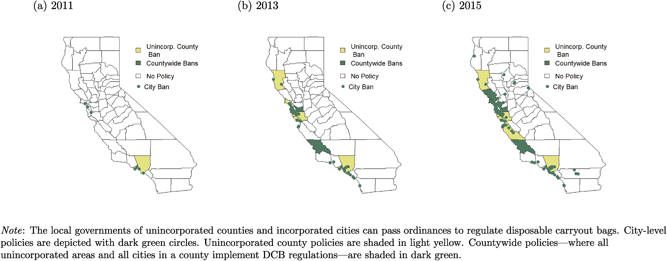
Bag Leakage: The Effect of Disposable Carryout Bag
Regulations on Unregulated Bags
By: Dr. Rebecca Taylor

Slide 15
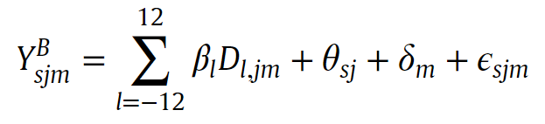
Bag Leakage: The Effect of Disposable Carryout Bag
Regulations on Unregulated Bags
By: Dr. Rebecca Taylor

Slide 16
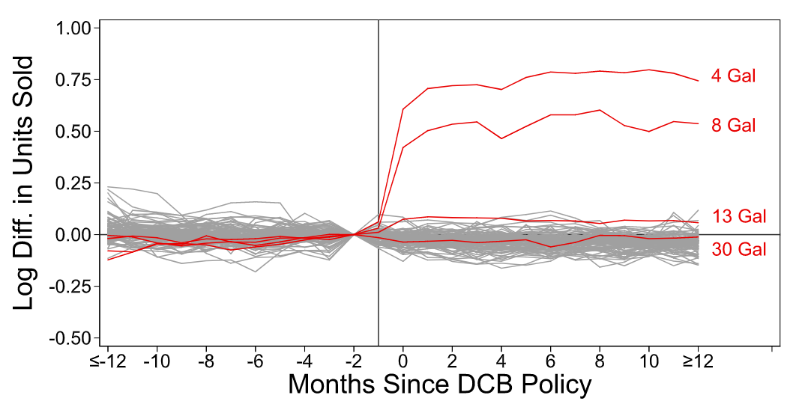

Slide 17
Downwind and out: The strategic dispersion
of power plants and their pollution
By: Dr. John Morehouse and Dr. Ed Rubin
Abstract: In federalist systems, local governments can maximize local welfare by exporting locally produced negative externalities. We empirically substantiate this externality-export strategy for air pollution using historical power-plant siting, administrative borders, and prevailing wind directions. Using a simple, non-parametric test, we show that decision-makers disproportionately sited coal-fueled plants to reduce counties’/states’ downwind pollution exposure. Natural-gas-fueled plants—lower polluters—did not follow this strategy. We then illustrate the extreme exportabilitiy of coal plants’ pollution: within 6 hours, 50% of coal plants’ emissions leave their source states—and 99% depart source counties. These results highlight how local strategic responses challenge federalist systems.

Slide 18
Downwind and out: The strategic dispersion
of power plants and their pollution
By: Dr. John Morehouse and Dr. Ed Rubin
Abstract: In federalist systems, local governments can maximize local welfare by exporting locally produced negative externalities. We empirically substantiate this externality-export strategy for air pollution using historical power-plant siting, administrative borders, and prevailing wind directions. Using a simple, non-parametric test, we show that decision-makers disproportionately sited coal-fueled plants to reduce counties’/states’ downwind pollution exposure. Natural-gas-fueled plants—lower polluters—did not follow this strategy. We then illustrate the extreme exportabilitiy of coal plants’ pollution: within 6 hours, 50% of coal plants’ emissions leave their source states—and 99% depart source counties. These results highlight how local strategic responses challenge federalist systems.

Slide 19
Downwind and out: The strategic dispersion
of power plants and their pollution
By: Dr. John Morehouse and Dr. Ed Rubin
Abstract: In federalist systems, local governments can maximize local welfare by exporting locally produced negative externalities. We empirically substantiate this externality-export strategy for air pollution using historical power-plant siting, administrative borders, and prevailing wind directions. Using a simple, non-parametric test, we show that decision-makers disproportionately sited coal-fueled plants to reduce counties’/states’ downwind pollution exposure. Natural-gas-fueled plants—lower polluters—did not follow this strategy. We then illustrate the extreme exportabilitiy of coal plants’ pollution: within 6 hours, 50% of coal plants’ emissions leave their source states—and 99% depart source counties. These results highlight how local strategic responses challenge federalist systems.

Slide 20
Downwind and out: The strategic dispersion
of power plants and their pollution
By: Dr. John Morehouse and Dr. Ed Rubin
Abstract: In federalist systems, local governments can maximize local welfare by exporting locally produced negative externalities. We empirically substantiate this externality-export strategy for air pollution using historical power-plant siting, administrative borders, and prevailing wind directions. Using a simple, non-parametric test, we show that decision-makers disproportionately sited coal-fueled plants to reduce counties’/states’ downwind pollution exposure. Natural-gas-fueled plants—lower polluters—did not follow this strategy. We then illustrate the extreme exportabilitiy of coal plants’ pollution: within 6 hours, 50% of coal plants’ emissions leave their source states—and 99% depart source counties. These results highlight how local strategic responses challenge federalist systems.

Slide 21
Downwind and out: The strategic dispersion
of power plants and their pollution
By: Dr. John Morehouse and Dr. Ed Rubin
Abstract: In federalist systems, local governments can maximize local welfare by exporting locally produced negative externalities. We empirically substantiate this externality-export strategy for air pollution using historical power-plant siting, administrative borders, and prevailing wind directions. Using a simple, non-parametric test, we show that decision-makers disproportionately sited coal-fueled plants to reduce counties’/states’ downwind pollution exposure. Natural-gas-fueled plants—lower polluters—did not follow this strategy. We then illustrate the extreme exportabilitiy of coal plants’ pollution: within 6 hours, 50% of coal plants’ emissions leave their source states—and 99% depart source counties. These results highlight how local strategic responses challenge federalist systems.

Slide 22
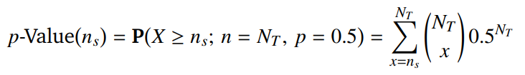
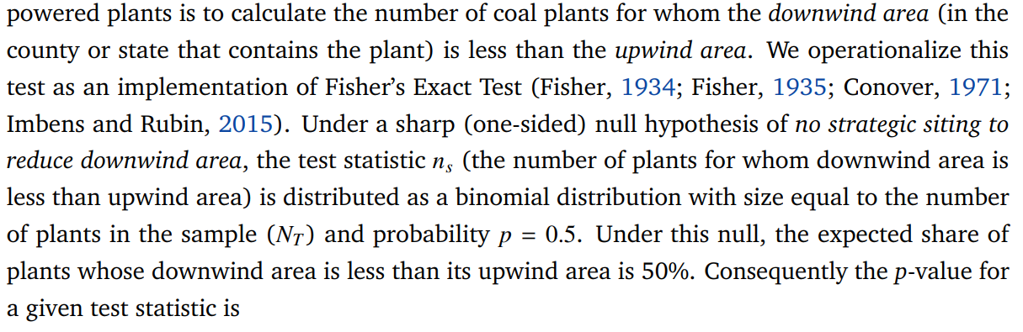
Downwind and out: The strategic dispersion
of power plants and their pollution
By: Dr. John Morehouse and Dr. Ed Rubin

Slide 23
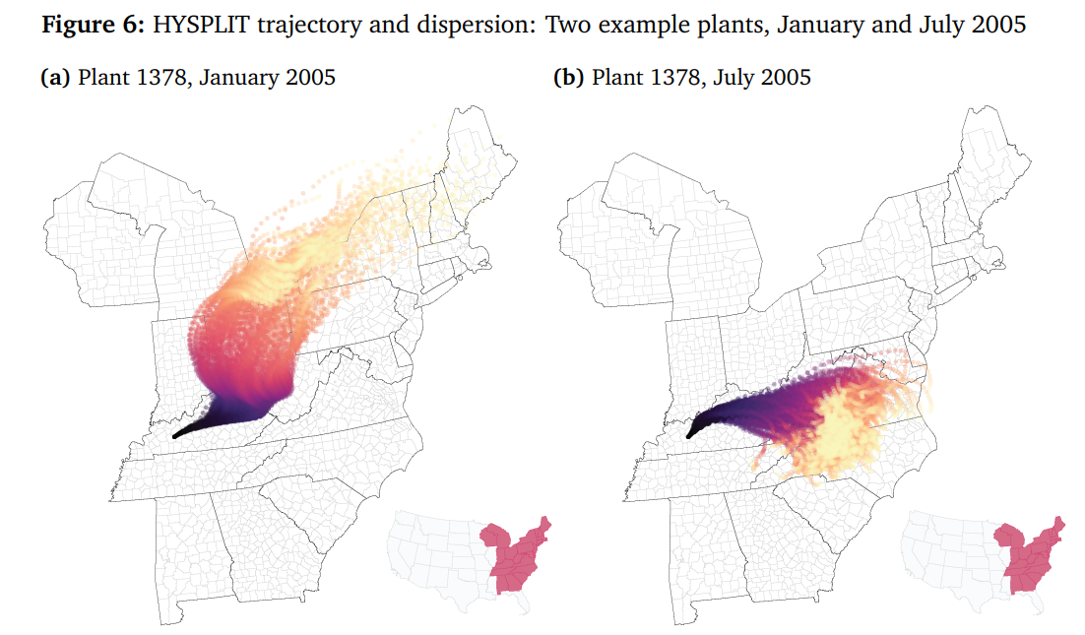
Downwind and out: The strategic dispersion
of power plants and their pollution
By: Dr. John Morehouse and Dr. Ed Rubin

Slide 24
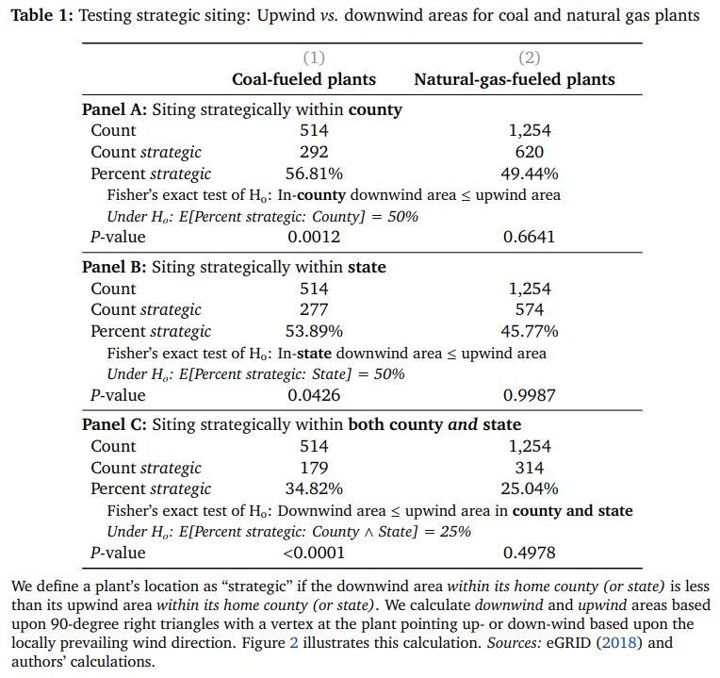

Slide 28
Should congested cities reduce their speed limits? Evidence from São Paulo, Brazil
By: Dr. Amanda Ang et al.
Abstract: Road accidents are the leading cause of unnatural deaths worldwide. Cities are experimenting with more stringent speed limits in an effort to reduce them. The impacts of these policies are unclear in many developing country cities, where a disproportionate share of accident damages occur but also where speed regulations could exacerbate already high levels of congestion. We evaluate a speed limit reduction program in São Paulo, Brazil using a dynamic event study design and measurements of 125 thousand traffic accidents, 38 million traffic tickets issued by monitoring cameras, and 1.4 million repeat observations of real-time trip durations before and after a regulatory change. We find that the program resulted in 1889 averted accidents within the first 18 months and reduced accidents by 21.7% on treated roads, with larger effects on roads with camera-based enforcement. The program also affected travel times on treated roads (5.5%), though the social benefits from reduced accidents are at least 1.32 times larger than the social costs of longer trip times. The benefits of accident reductions accrue largely to lower income pedestrians and motorcyclists, indicating that speed limit reductions may have important impacts on low-income residents in developing country cities.

Slide 29
Should congested cities reduce their speed limits? Evidence from São Paulo, Brazil
By: Dr. Amanda Ang et al.
Abstract: Road accidents are the leading cause of unnatural deaths worldwide. Cities are experimenting with more stringent speed limits in an effort to reduce them. The impacts of these policies are unclear in many developing country cities, where a disproportionate share of accident damages occur but also where speed regulations could exacerbate already high levels of congestion. We evaluate a speed limit reduction program in São Paulo, Brazil using a dynamic event study design and measurements of 125 thousand traffic accidents, 38 million traffic tickets issued by monitoring cameras, and 1.4 million repeat observations of real-time trip durations before and after a regulatory change. We find that the program resulted in 1889 averted accidents within the first 18 months and reduced accidents by 21.7% on treated roads, with larger effects on roads with camera-based enforcement. The program also affected travel times on treated roads (5.5%), though the social benefits from reduced accidents are at least 1.32 times larger than the social costs of longer trip times. The benefits of accident reductions accrue largely to lower income pedestrians and motorcyclists, indicating that speed limit reductions may have important impacts on low-income residents in developing country cities.

Slide 30
Should congested cities reduce their speed limits? Evidence from São Paulo, Brazil
By: Dr. Amanda Ang et al.
Abstract: Road accidents are the leading cause of unnatural deaths worldwide. Cities are experimenting with more stringent speed limits in an effort to reduce them. The impacts of these policies are unclear in many developing country cities, where a disproportionate share of accident damages occur but also where speed regulations could exacerbate already high levels of congestion. We evaluate a speed limit reduction program in São Paulo, Brazil using a dynamic event study design and measurements of 125 thousand traffic accidents, 38 million traffic tickets issued by monitoring cameras, and 1.4 million repeat observations of real-time trip durations before and after a regulatory change. We find that the program resulted in 1889 averted accidents within the first 18 months and reduced accidents by 21.7% on treated roads, with larger effects on roads with camera-based enforcement. The program also affected travel times on treated roads (5.5%), though the social benefits from reduced accidents are at least 1.32 times larger than the social costs of longer trip times. The benefits of accident reductions accrue largely to lower income pedestrians and motorcyclists, indicating that speed limit reductions may have important impacts on low-income residents in developing country cities.

Slide 31
Should congested cities reduce their speed limits? Evidence from São Paulo, Brazil
By: Dr. Amanda Ang et al.
Abstract: Road accidents are the leading cause of unnatural deaths worldwide. Cities are experimenting with more stringent speed limits in an effort to reduce them. The impacts of these policies are unclear in many developing country cities, where a disproportionate share of accident damages occur but also where speed regulations could exacerbate already high levels of congestion. We evaluate a speed limit reduction program in São Paulo, Brazil using a dynamic event study design and measurements of 125 thousand traffic accidents, 38 million traffic tickets issued by monitoring cameras, and 1.4 million repeat observations of real-time trip durations before and after a regulatory change. We find that the program resulted in 1889 averted accidents within the first 18 months and reduced accidents by 21.7% on treated roads, with larger effects on roads with camera-based enforcement. The program also affected travel times on treated roads (5.5%), though the social benefits from reduced accidents are at least 1.32 times larger than the social costs of longer trip times. The benefits of accident reductions accrue largely to lower income pedestrians and motorcyclists, indicating that speed limit reductions may have important impacts on low-income residents in developing country cities.

Slide 32
Should congested cities reduce their speed limits? Evidence from São Paulo, Brazil
By: Dr. Amanda Ang et al.
Abstract: Road accidents are the leading cause of unnatural deaths worldwide. Cities are experimenting with more stringent speed limits in an effort to reduce them. The impacts of these policies are unclear in many developing country cities, where a disproportionate share of accident damages occur but also where speed regulations could exacerbate already high levels of congestion. We evaluate a speed limit reduction program in São Paulo, Brazil using a dynamic event study design and measurements of 125 thousand traffic accidents, 38 million traffic tickets issued by monitoring cameras, and 1.4 million repeat observations of real-time trip durations before and after a regulatory change. We find that the program resulted in 1889 averted accidents within the first 18 months and reduced accidents by 21.7% on treated roads, with larger effects on roads with camera-based enforcement. The program also affected travel times on treated roads (5.5%), though the social benefits from reduced accidents are at least 1.32 times larger than the social costs of longer trip times. The benefits of accident reductions accrue largely to lower income pedestrians and motorcyclists, indicating that speed limit reductions may have important impacts on low-income residents in developing country cities.

Slide 33
Should congested cities reduce their speed limits? Evidence from São Paulo, Brazil
By: Dr. Amanda Ang et al.
Abstract: Road accidents are the leading cause of unnatural deaths worldwide. Cities are experimenting with more stringent speed limits in an effort to reduce them. The impacts of these policies are unclear in many developing country cities, where a disproportionate share of accident damages occur but also where speed regulations could exacerbate already high levels of congestion. We evaluate a speed limit reduction program in São Paulo, Brazil using a dynamic event study design and measurements of 125 thousand traffic accidents, 38 million traffic tickets issued by monitoring cameras, and 1.4 million repeat observations of real-time trip durations before and after a regulatory change. We find that the program resulted in 1889 averted accidents within the first 18 months and reduced accidents by 21.7% on treated roads, with larger effects on roads with camera-based enforcement. The program also affected travel times on treated roads (5.5%), though the social benefits from reduced accidents are at least 1.32 times larger than the social costs of longer trip times. The benefits of accident reductions accrue largely to lower income pedestrians and motorcyclists, indicating that speed limit reductions may have important impacts on low-income residents in developing country cities.

Slide 34
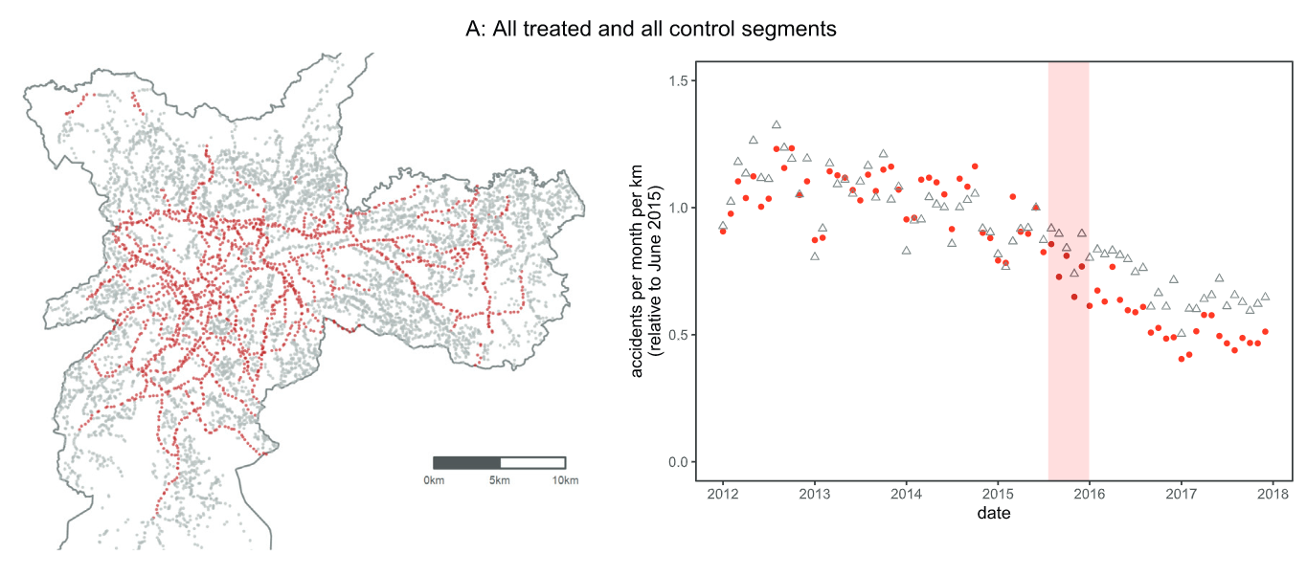
Should congested cities reduce their speed limits? Evidence from São Paulo, Brazil
By: Dr. Amanda Ang et al.

Slide 35
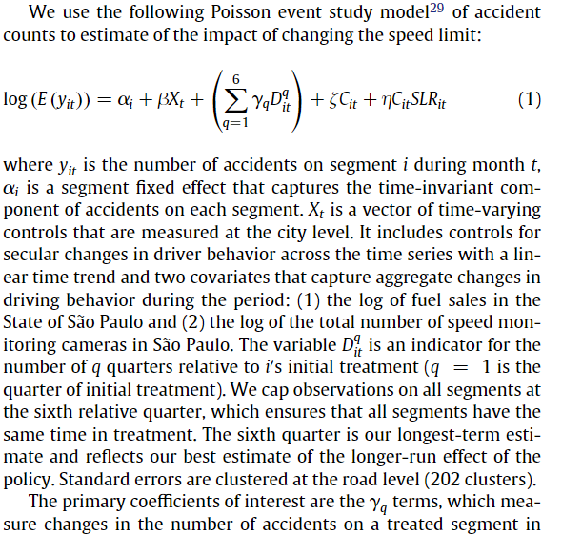
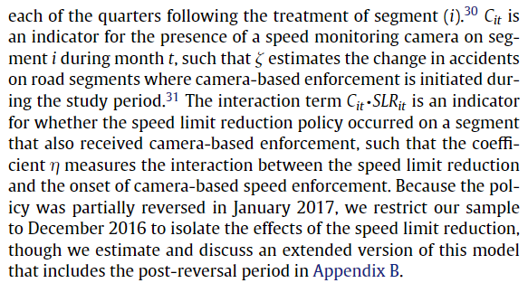
Should congested cities reduce their speed limits? Evidence from São Paulo, Brazil
By: Dr. Amanda Ang et al.

Slide 36
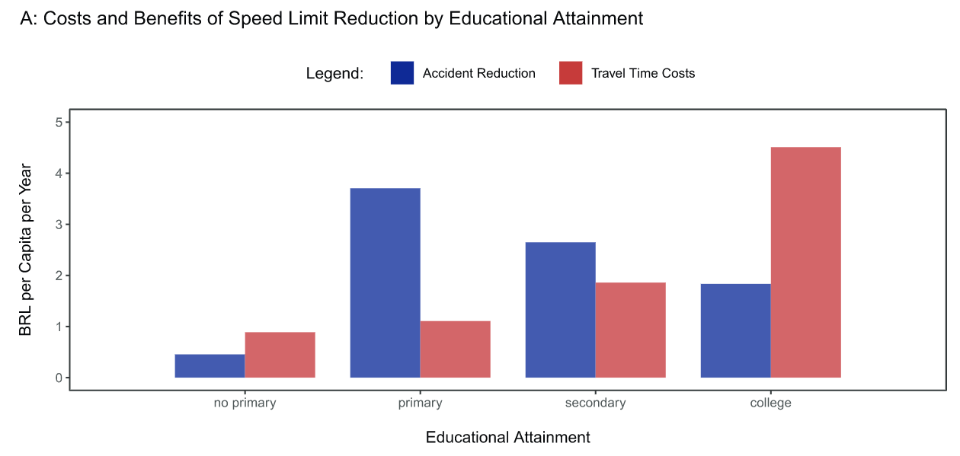
Should congested cities reduce their speed limits? Evidence from São Paulo, Brazil
By: Dr. Amanda Ang et al.

Slide 37
Air Pollution from Agricultural Fires Increases Hypertension Risk
By: Hemant Pullabhotla and Dr. Mateus Souza
Abstract: In many parts of the developing world, farmers widely use deliberate fires to burn vegetation and clear land to plant crops. These agricultural fires, however, are known to be associated with health costs due to increased air pollution. We contribute to underpinning the associated health cost estimates by studying the effects of these fires on hypertension risk. Despite being one of the leading causes of mortality globally, there is little direct evidence on how hypertension risk changes with exposure to pollution from agricultural fires. To overcome common data and empirical challenges in this setting, we match blood pressure readings from nearly 784,000 individuals across India with satellite data on 1.2 million agricultural fires, wind direction realizations, and local ambient air pollution. We find that the incidence of hypertension increases by 1.8% for each standard deviation increase in the number of upwind fires observed one day before the blood pressure readings. We find that the impact is stronger among older males, smokers, individuals that were already on blood pressure medication, and individuals belonging to socially marginalized groups. Our estimates suggest that agricultural fires in India lead to hypertension-related additional mortality, associated with USD 9 billion annually in costs.

Slide 38
Air Pollution from Agricultural Fires Increases Hypertension Risk
By: Hemant Pullabhotla and Dr. Mateus Souza
Abstract: In many parts of the developing world, farmers widely use deliberate fires to burn vegetation and clear land to plant crops. These agricultural fires, however, are known to be associated with health costs due to increased air pollution. We contribute to underpinning the associated health cost estimates by studying the effects of these fires on hypertension risk. Despite being one of the leading causes of mortality globally, there is little direct evidence on how hypertension risk changes with exposure to pollution from agricultural fires. To overcome common data and empirical challenges in this setting, we match blood pressure readings from nearly 784,000 individuals across India with satellite data on 1.2 million agricultural fires, wind direction realizations, and local ambient air pollution. We find that the incidence of hypertension increases by 1.8% for each standard deviation increase in the number of upwind fires observed one day before the blood pressure readings. We find that the impact is stronger among older males, smokers, individuals that were already on blood pressure medication, and individuals belonging to socially marginalized groups. Our estimates suggest that agricultural fires in India lead to hypertension-related additional mortality, associated with USD 9 billion annually in costs.

Slide 39
Air Pollution from Agricultural Fires Increases Hypertension Risk
By: Hemant Pullabhotla and Dr. Mateus Souza
Abstract: In many parts of the developing world, farmers widely use deliberate fires to burn vegetation and clear land to plant crops. These agricultural fires, however, are known to be associated with health costs due to increased air pollution. We contribute to underpinning the associated health cost estimates by studying the effects of these fires on hypertension risk. Despite being one of the leading causes of mortality globally, there is little direct evidence on how hypertension risk changes with exposure to pollution from agricultural fires. To overcome common data and empirical challenges in this setting, we match blood pressure readings from nearly 784,000 individuals across India with satellite data on 1.2 million agricultural fires, wind direction realizations, and local ambient air pollution. We find that the incidence of hypertension increases by 1.8% for each standard deviation increase in the number of upwind fires observed one day before the blood pressure readings. We find that the impact is stronger among older males, smokers, individuals that were already on blood pressure medication, and individuals belonging to socially marginalized groups. Our estimates suggest that agricultural fires in India lead to hypertension-related additional mortality, associated with USD 9 billion annually in costs.

Slide 40
Air Pollution from Agricultural Fires Increases Hypertension Risk
By: Hemant Pullabhotla and Dr. Mateus Souza
Abstract: In many parts of the developing world, farmers widely use deliberate fires to burn vegetation and clear land to plant crops. These agricultural fires, however, are known to be associated with health costs due to increased air pollution. We contribute to underpinning the associated health cost estimates by studying the effects of these fires on hypertension risk. Despite being one of the leading causes of mortality globally, there is little direct evidence on how hypertension risk changes with exposure to pollution from agricultural fires. To overcome common data and empirical challenges in this setting, we match blood pressure readings from nearly 784,000 individuals across India with satellite data on 1.2 million agricultural fires, wind direction realizations, and local ambient air pollution. We find that the incidence of hypertension increases by 1.8% for each standard deviation increase in the number of upwind fires observed one day before the blood pressure readings. We find that the impact is stronger among older males, smokers, individuals that were already on blood pressure medication, and individuals belonging to socially marginalized groups. Our estimates suggest that agricultural fires in India lead to hypertension-related additional mortality, associated with USD 9 billion annually in costs.

Slide 41
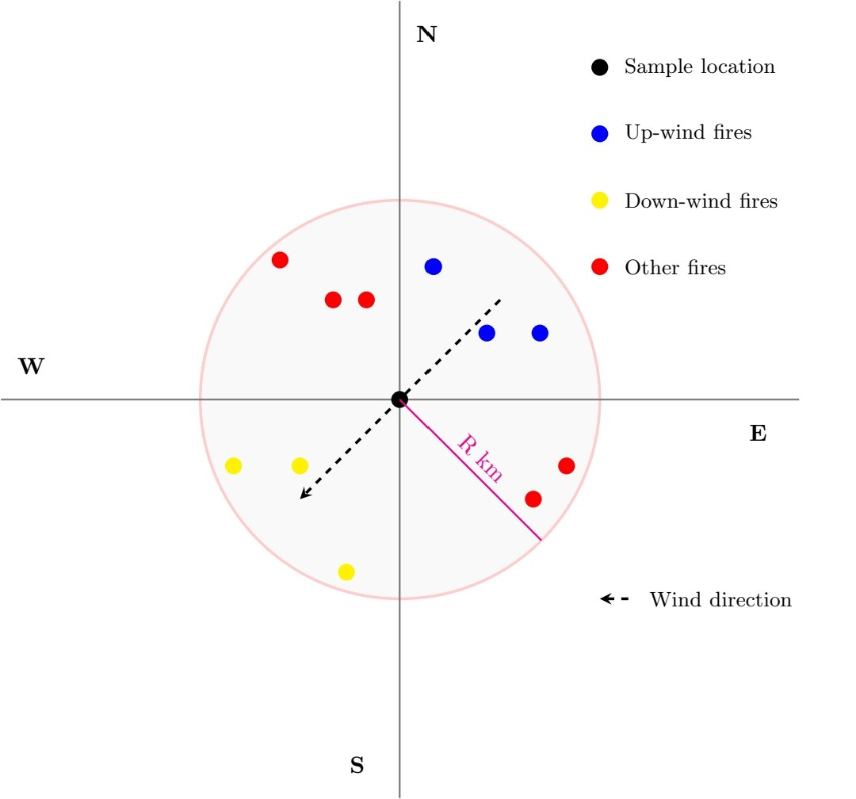
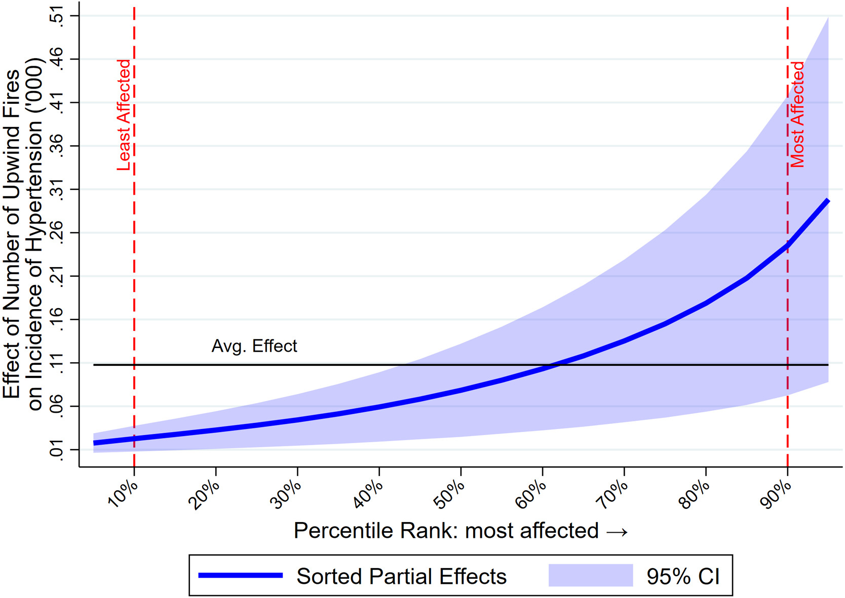
Air pollution from agricultural fires increases hypertension risk
By: Hemant Pullabhotla and Dr. Mateus Souza

Slide 42
Next Week
Tuesday, Sept 6th is on a “Monday” Schedule
Wrapping up Module 1 with a class on positive versus normative notions in applied economics
Wednesday, Sept 7th is a regularly scheduled class
Beginning Module 2 with econometrics and treatment effects
Saturday, Sept 10th your first reflection post is due

